Slide 1
Lecture 5: Collaborative Programming and Basic HTML

Slide 2
Collaborative Programming

Slide 3
How do we code collaboratively?
Learning to code in collaboration with others is a very important skill to learn for your life as a developer.
We can code collaboratively by using a combination of version control software, ticketing systems, and workflows to distribute work amongst our team members.

Slide 4
What is version control?
Version control is a system that records sets of changes over time. It allows you to keep track of a history of your files in a very detailed manner.
Version control allows you to see a detailed log of all your changes, as well as roll changes back. It allows you a great deal of control over the state of your files; you can make many, many versions of your code and change between the versions with ease!
This allows for easy feature development.

Slide 5
What is Git?
Git is an extremely popular version control software that is commonly used both personally and professionally. It is the most widely used version control software at the current point in time.
It was originally created by Linus Torvalds, who happens to also be the creator of the Linux Kernel.
Git is a distributed version control system: everyone will make a copy of a codebase to work off of on their local machine, and changes on one machine will not affect changes on another machine.

Slide 6
How can we use Git?
Git is a command line program, so we will use it from our terminal (much like node)
https://git-scm.com/
Most of our commands are simple, and we will use Git to work collaboratively.
We will, in general, use Git by setting up a centralized repository that we will publish code to and we will synchronize changes in our local repositories.
For most of our work, we will be using Github to store an online copy of our repository.

Slide 7
Distributing Work
The easiest way to work in a team is to distribute work.
Very often, work is distributed in one of the following forms:
Feature based; each team member owns a portion of the features and does all the work for that area. This includes: server routes, data code, HTML, CSS, and frontend JavaScript
Architectural ownership; each team member takes a region of the code to own. One user will work on authentication, one will work on routes, one will work on CSS, one on JS, etc.
Ticket based; a series of tickets are created regarding each issue, bug, feature, etc., and developers claim tickets to work on.

Slide 8
Using a ticket system
Ticketing systems are a popular way to keep track of issues and features. Project managers often use this software to manage the team workload. You may find this useful for your projects.
Some popular ticket systems / project management apps:
Asana
http://asana.com/
Trello
http://trello.com/
Github issues
https://developer.github.com/v3/issues/
Mingle
https://www.thoughtworks.com/mingle/
Waffle
https://waffle.io/

Slide 9
Git

Slide 10
Terms
Term | Meaning
Repository | A repository is a location that stores the information about the project’s file and folder structure, as well as its history
Branch | A branch is a pointer to a certain chain of file change histories; you can have many branches, but will always have at least one. Traditionally, the original branch is called master
Commit | A commit is a snapshot of your repository at a point in time.
Remote | A reference to a repository stored outside of your current local machine; ie, the repository on Github
Push | Pushing is the act of taking your commits and uploading them to a remote repository
Pull | Pulling is the act of taking commits from a remote repository and bringing the changes down to your local repository
Merging | Merging is the act of bringing one set of changes from one branch to another, and creating a new version of the code with both histories.
Pull request | A pull request is a request to bring a series of changes from one branch to another

Slide 11
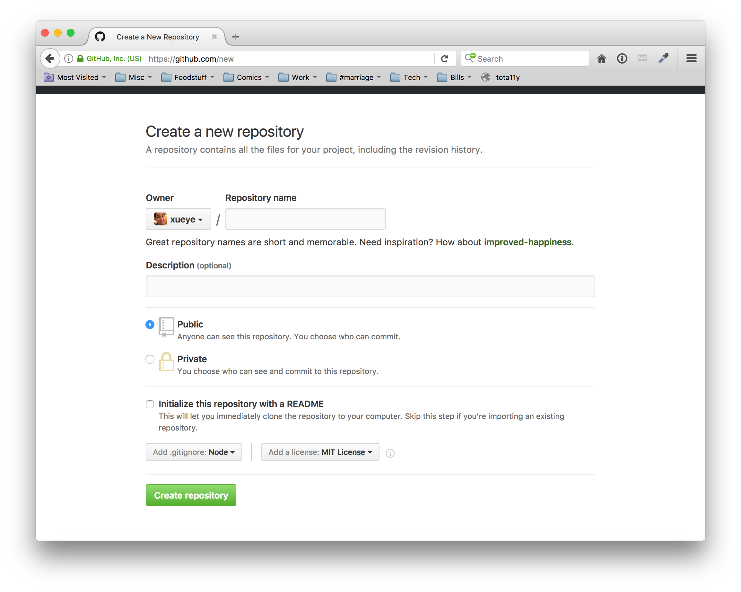
Making a repository on Github
The first step to using Git is making a repository. A repository is a data structure that stores information about the files and folder of a project, as well as the history of the structure.
The easiest way to make a repository is to start on Github, with the following settings:
https://github.com/new

Slide 12
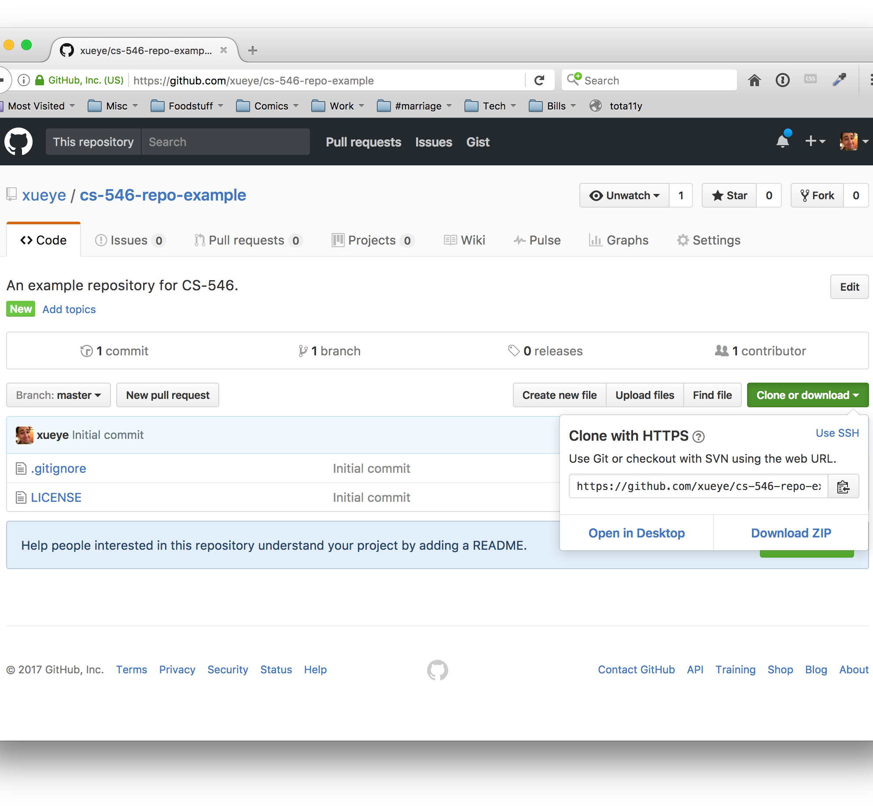
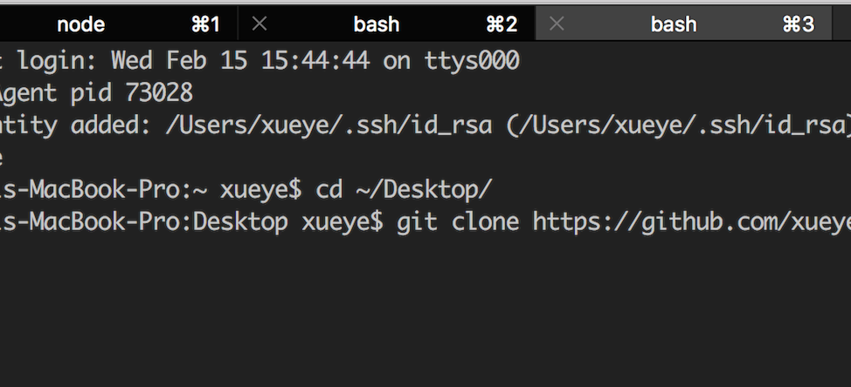
Cloning a repository
Once the repository is created on Github, we can clone it to our local machines using the git command line.
On the home page of a repository (see example) there will be a button to clone or donwload the repository. Copy the url, and use the git clone URL command to clone the repository.

Slide 13
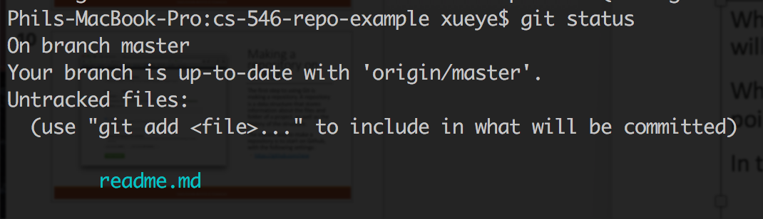
Getting status
While in our project directory, we can make changes as needed to our repository. These changes will not appear online until we commit and push these changes.
When we want to see what changes we have since our last commit (a snapshot of our code at a point in time), we can use the git status command.
In the screenshot, we can see that we have an untracked file; this means a file that is brand new to the repository.

Slide 14
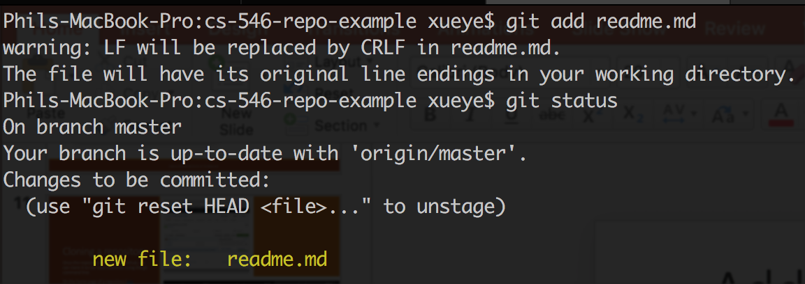
Adding changes to be included in a commit
Before we commit changes, we need to explicitly tell Git which files we want to track the changes of. We do this with the git add PATH/TO/FILE.EXT command.
For example, to add our new readme, it would be: git add readme.md
After the file is added, it is now in a state known as staging; this means that it’s a change that will be included in a new commit. We can continue to edit this file and the new changes will not be included in that staging version of the file until we explicitly run git add again.

Slide 15
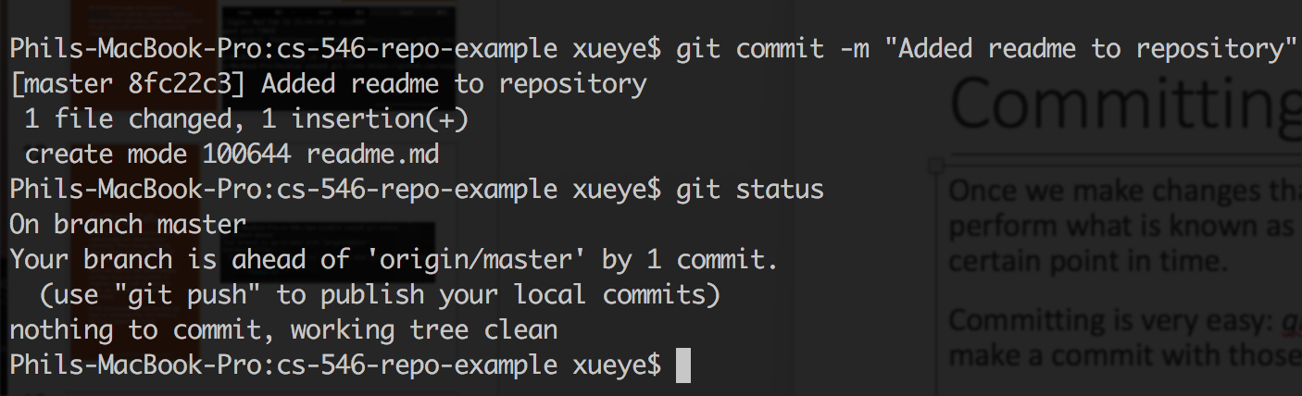
Committing Code
Once we make changes that we want to group together and store in our repository, we will perform what is known as a commit. A commit can be seen as a snapshot of our repository at a certain point in time.
Committing is very easy: git commit -m “Our message here” will snapshot all staged changes and make a commit with those changes.

Slide 16
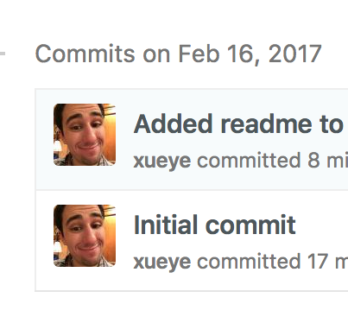
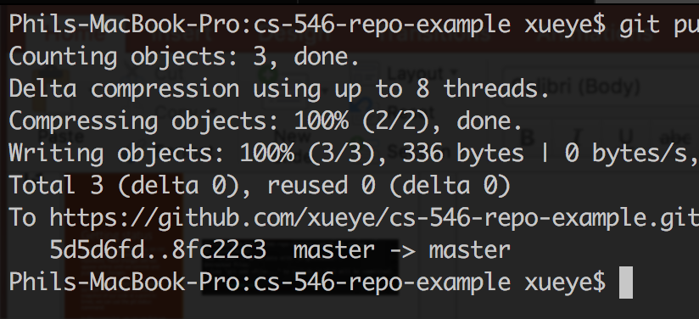
Pushing up our changes
Version control is incredibly useful when using a single computer, but shines even more when we push our changes up to a remote repository. By default, when we clone, a reference to the online repository will be created; this repository is named origin.
We can push our changes by using the git push REPOSITORY_NAME BRANCH_NAME, like git push origin master
After pushing, our commits will be seen online

Slide 17
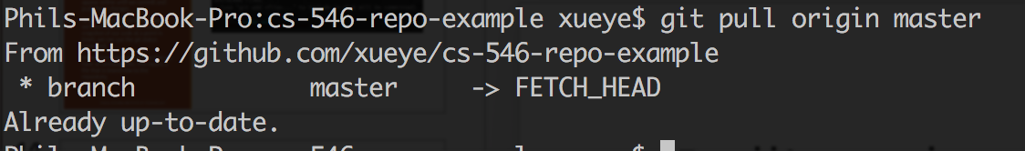
Pulling changes
We can pull down changes in the same manner, by issuing a git pull REPOSITORY_NAME BRANCH_NAME command. If there are changes, you will automatically pull and merge these changes into the branch your are currently in.

Slide 18
An easy workflow
Let us pretend for a moment that we want to make a series of updates to our readme file. A common workflow is:
Make a new branch devoted to all changes to the readme, such as git checkout -b feature/readme
Make relevant updates to the codebase
Make as many commits as needed until satisfied with the result
As you commit, push your changes up to a remote branch; the first time you push to a new branch online, it will be created online!
When done with the feature, issue a pull request for the code to be reviewed.
When the code is reviewed and accepted, merge it into the main branch.

Slide 19
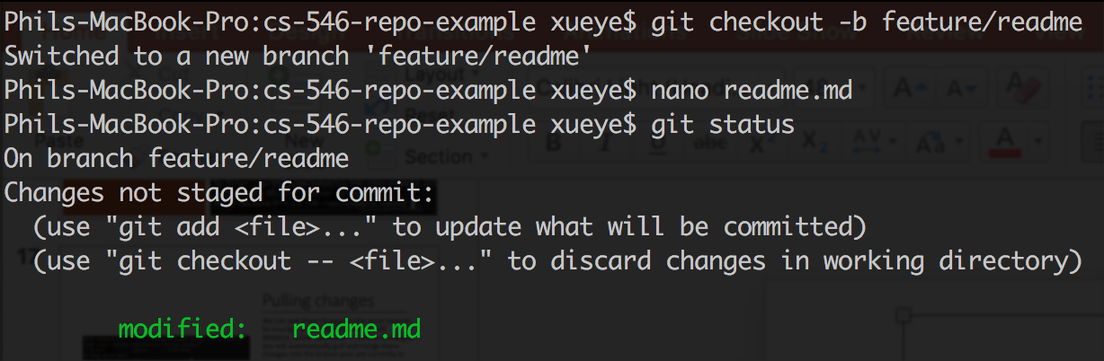
Workflow Demonstration: Branching and saving changes
At this point, we have created a new branch using the git checkout -b feature/readme command; this creates a new branch named feature/readme; if we already had that branch and were just moving to the branch, we would omit the –b flag.

Slide 20
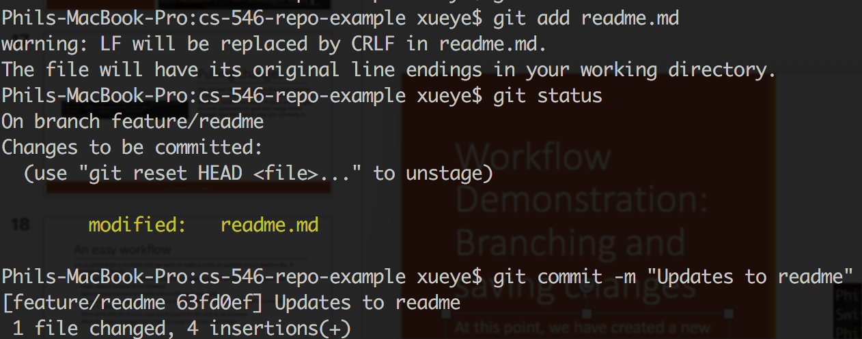
Workflow Demonstration: Staging and Committing
On our new branch, we now stage the files by adding them to be committed; then, we commit the code.

Slide 21
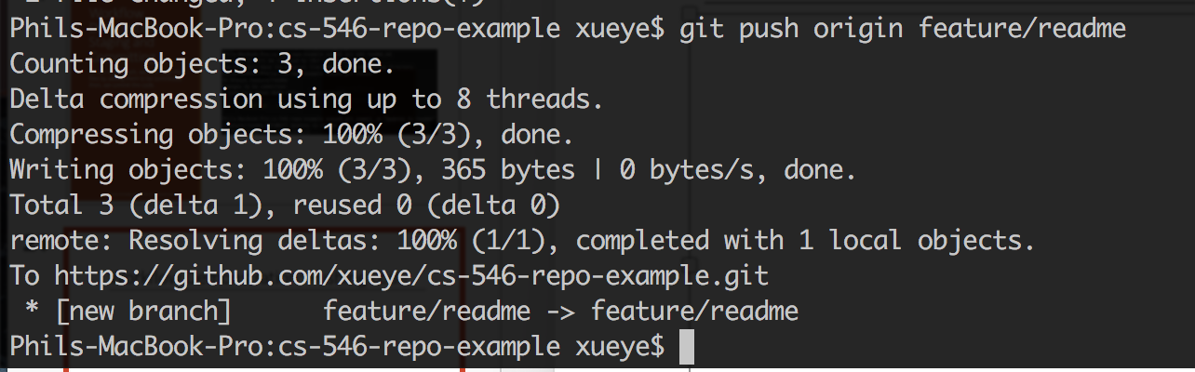
Workflow Demonstration: Pushing code
We push the code online to our remote repository; we should remember to do this often!

Slide 22
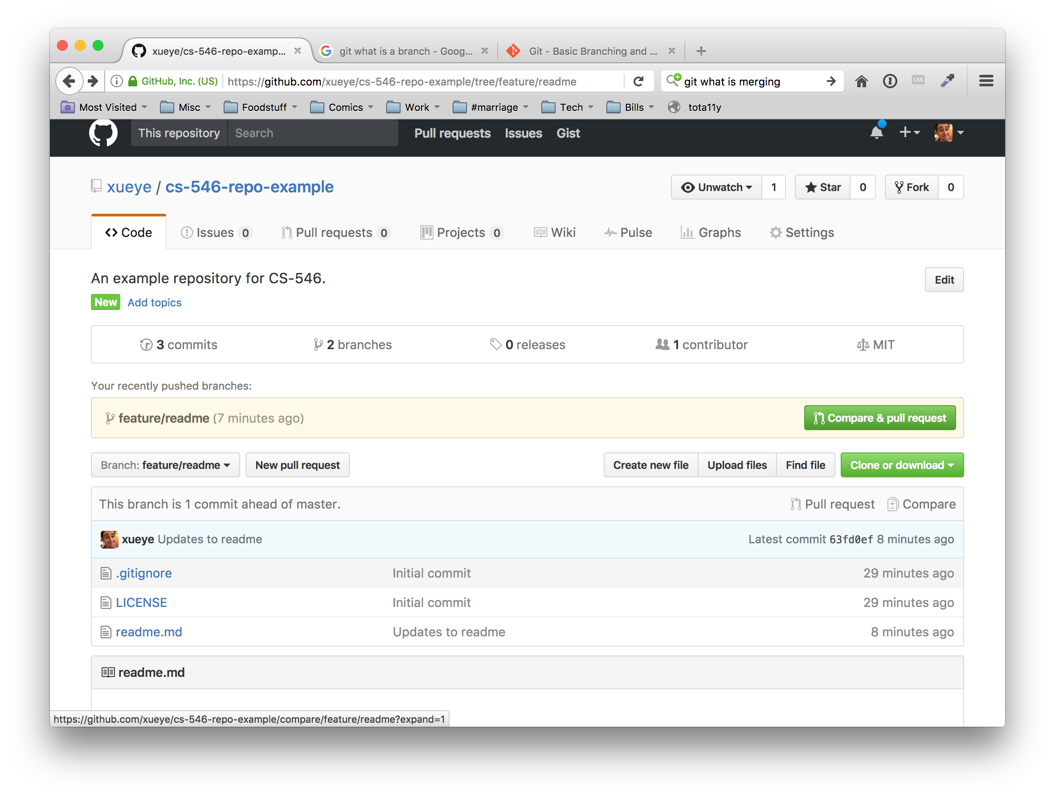
Making a pull request
On Github, we can create a pull request based on the branch. This will issue a request to have this changes merged into a different branch (in our case, master).

Slide 23
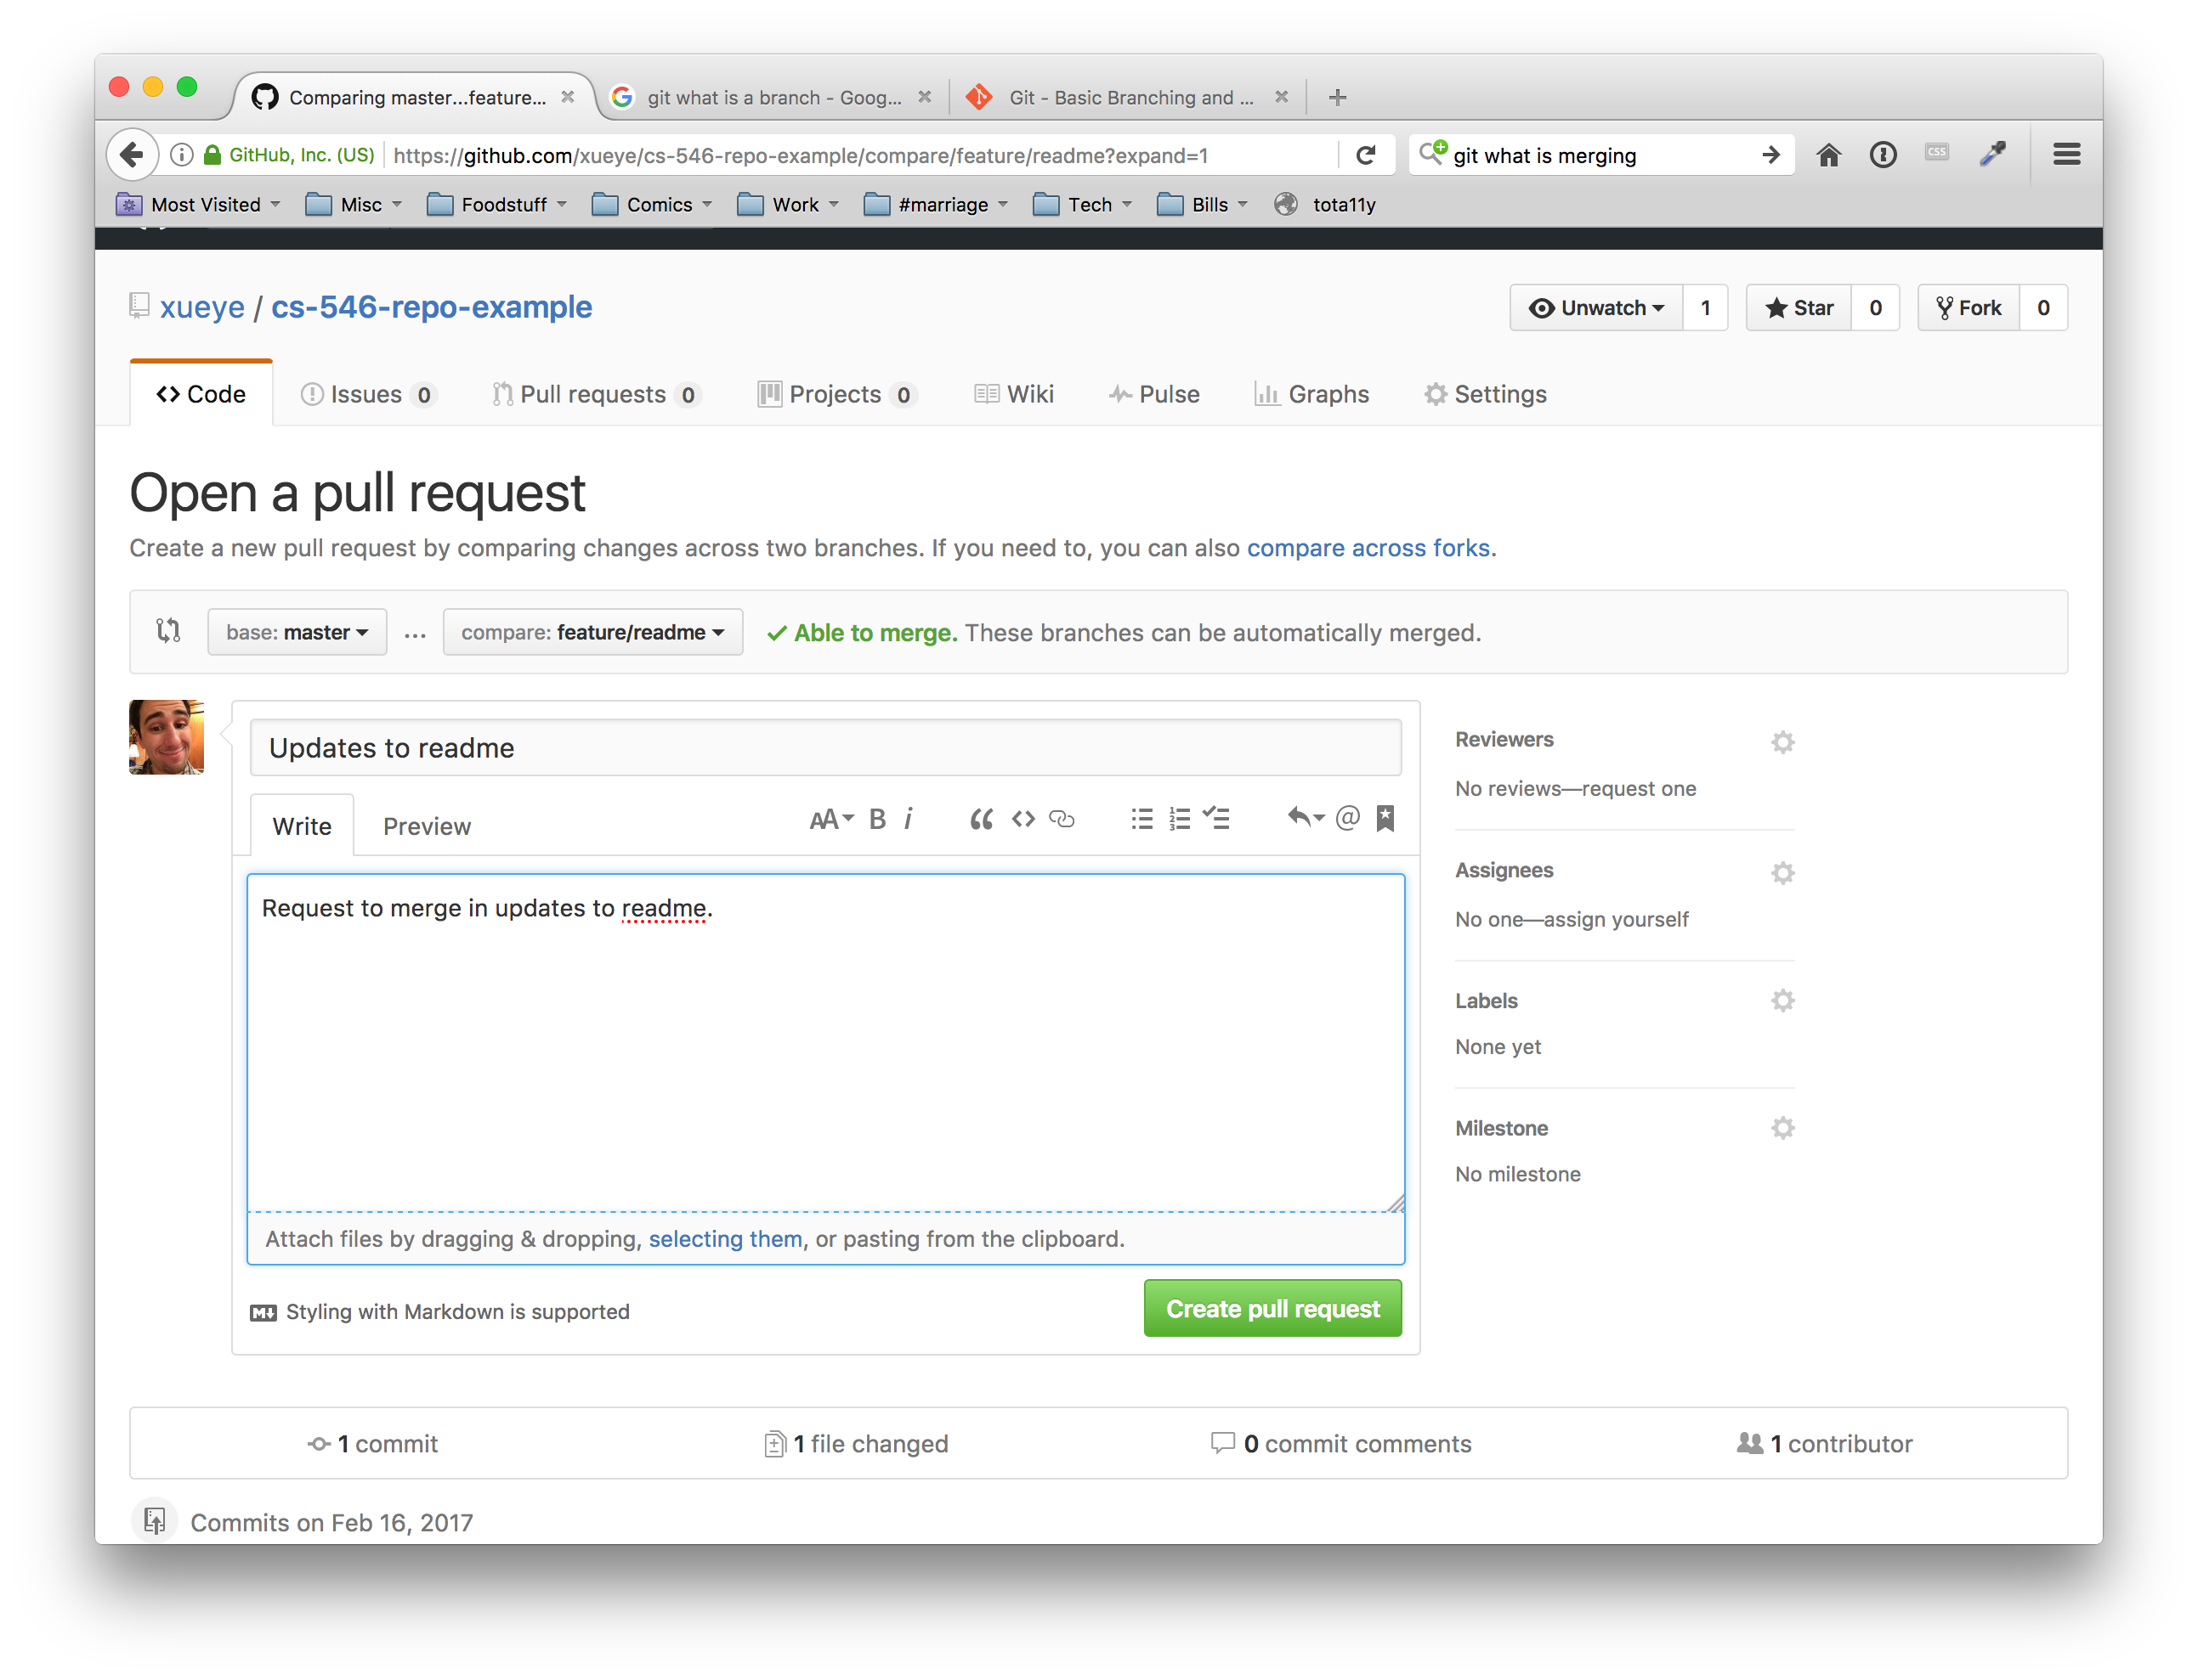
Making a pull request
Pull requests should have a description of the set of changes, and when created will show the changes in that branch.

Slide 24
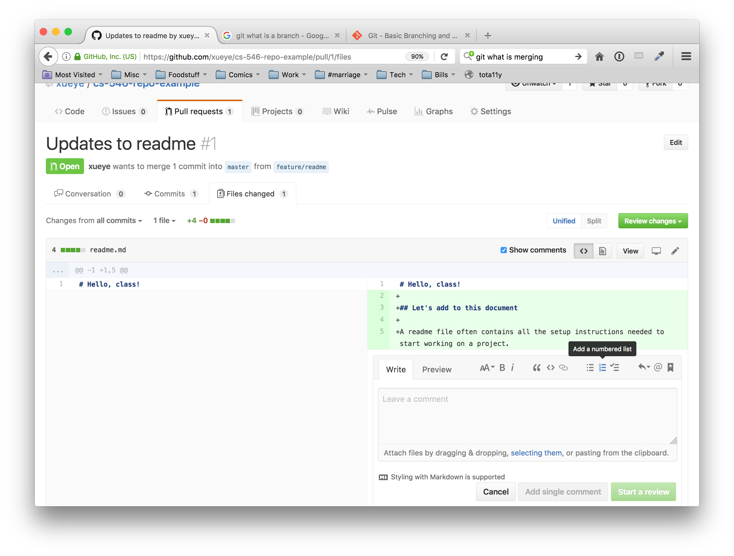
Reviewing a pull request
All pull requests should be reviewed by a different developer (and it’s also good to have it reviewed by more than one developer); by clicking the files changed tab on the pull request page, we can leave comments to the developer about their pull request.
This is very useful for identifying inefficiencies, logical errors, bugs, etc. It also forces multiple developers to look at the approach to solving a problem or making a feature, so that more than one developer is familiar with each portion of the code in a project.

Slide 25
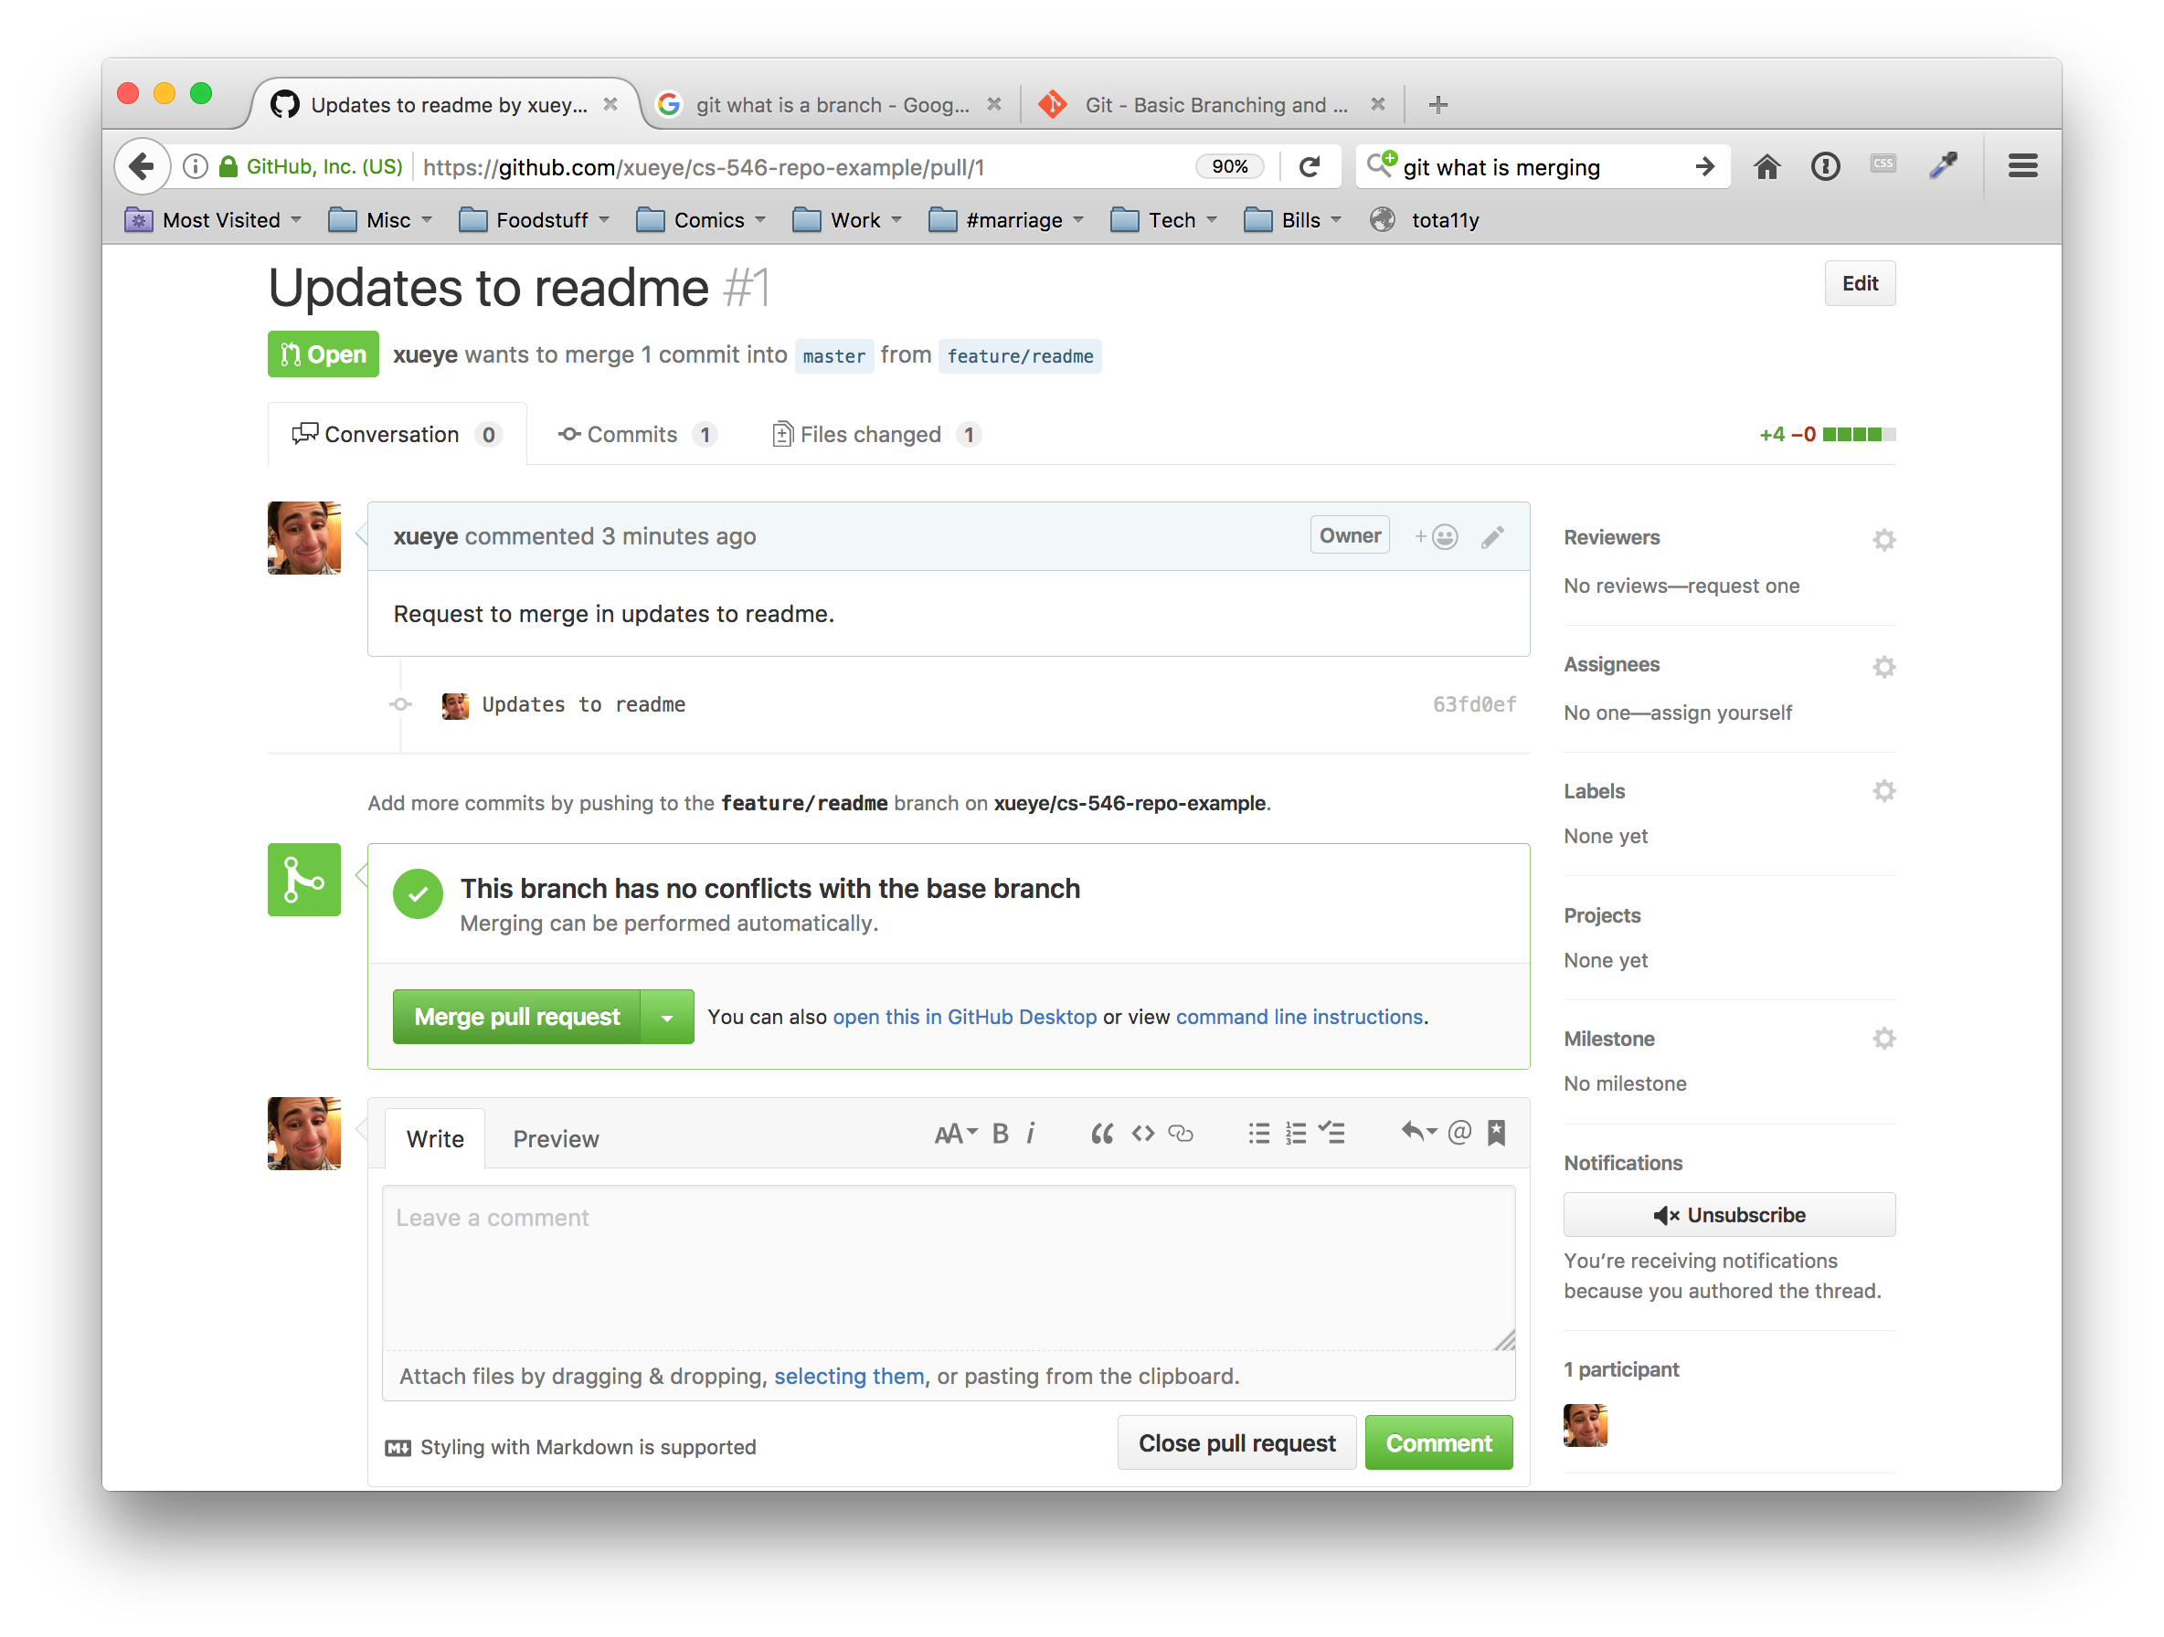
Merging in the pull request
If a pull request can be safely merged in without conflicts occurring, Github will allow you to merge in the changes when all developers are satisfied with the changes.
This will add the new commit data to the master branch of the online repository.

Slide 26
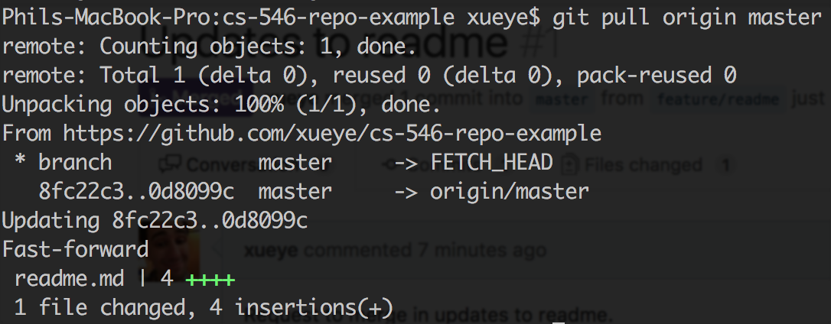
Pulling changes
At this point, the only repository with the new commit on the master branch is the online version; even the repository that we developed on does not have those changes on the master branch.
We need to routinely pull from the master branch to stay up to date.

Slide 27
Avoiding Issues
Many issues can occur when using version control, due to the nature of many people editing the same sets of files.
There are a few easy tricks to avoiding most common issues with Git:
Never develop on the master branch; do all development in your own feature branches, and issue pull requests.
Pull master into your own feature branches commonly; merge errors will occur that you will need to resolve by hand, but you will ultimately have to resolve these issues far less than if you were all working on the master branch
Isolate your work into small chunks; do not wait to do a whole feature before you commit. Commit often, as you accomplish small, incremental changes.
Make new feature branches off of master; master should always be the most up-to-date working code; it is prudent when starting a new feature to get an updated version of the master branch and make a new branch from that up-to-date master branch.
Pull often; this is so important, that we’re listing it twice. Pull often!

Slide 28
References
http://rogerdudler.github.io/git-guide/
https://git-scm.com/doc

Slide 29
Intro to HTML

Slide 30
Making an HTML document
HTML (Hyper Text Markup Language) is a markup language; it is a way of describing content. A file written in HTML is referred to as an HTML document.
Our first HTML documents will exist on our desktops, rather than on a server.
HTML documents are simply text files that are formed following the HTML standard. HTML is composed of a series of tags to describe the content.
An HTML document is a text document that describes a web page.
Your browser will interpret this document and render it!

Slide 31
What’s in an HTML Document?
An HTML has a series of elements
Open tag plus attributes and properties
Nested elements
Some very important
HTML Doctype
HTML Element
Head Element
Body Element
Elements can be identified by an ID
ID can only be used once per document
Elements can identify a group by their class
Elements are described in the document and rendered in the DOM

Slide 32
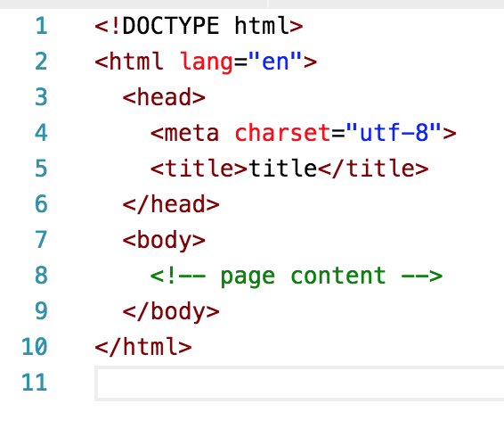
Starting an HTML document
All HTML documents start with the following barebones structure. Content to be visible on your page will go inside the body tag. (Colored formatted screenshot on left; copyable on right)
<!DOCTYPE html>
<html lang="en">
<head>
<meta charset="utf-8">
<title>title</title>
</head>
<body>
<!-- page content -->
</body>
</html>

Slide 33
Improving our HTML Documents
This week we’re going to create a meaningful document about different types of coffee, and explain how to make it marked up in a sensible way.
We will learn about:
Formatting text
Organizing our data
Lists
Tabular data

Slide 34
Reusability, repetition
For web programming, it’s very necessary to think of everything based in terms of reusable components. There’s a lot of repetition in web programming, where you’re displaying many different instances of similar data
Every tweet has all the same info
Every blog post has a title, time, body, etc.
Product descriptions all have prices, titles, etc.
Because of this, we’re going to look at our programming in terms of:
Is this reusable? If so, how?
How can I make this component accessible?
More on this when we get to forms next week.

Slide 35
The Browser’s Only Half The Battle
The web isn’t just accessible via a browser. As modern web developers, we have to care about:
Screen readers
Search Engine Crawlers / Other AI
There is a growing movement to make the web more accessible
Leveraging HTML’s strengths
Navs in the nav
Labels in forms
Using headings properly
Attributes to help screen readers
Making designs accessible
Tables for tabular data only
Make sure you can navigate via keyboard

Slide 36
Separating Style and Content
Before we can think in terms of organizing our data meaningfully, we need to understand what HTML does not accomplish; the way your document looks.
Elements are used to describe your data; CSS is used to style your data.
While browsers give many native styles to elements by default, elements are not inherently used for styling. This is why tags for bolding and italicizing text, or changing fonts, were deprecated in HTML5.
There needs to be a clear separation between style and content; any overlap is a happy coincidence.
While writing HTML, thinking in terms of content first, then styling often leads to more logical, and easier to style documents.

Slide 37
Types of Text
Across the web, text is used to portray many different types of things.
Headings / Titles in your content (h1, h2, h3, h4, h5, h6)
Regular paragraph (p)
Generic groups of text / adding custom definitions or functionality to text (span)
Emphasized text (em)
Important text (strong)
Addresses (addr)
Citations (cite)
Abbreviations (abbr)
Quotes (blockquote)
Using the right kind of element to describe text is very important for SEO, non-browser accessibility, and readable code.
Even without different styles, those tags help readers understand their document.
Notes:
Finally! We can talk about our elements.
It turns out that words are pretty versatile and mean dramatically different things depending on how you say or read them. With that in mind, HTML provides a number of tags that markup your text to convey what you want them to convey.
There are 6 headings tags. The heading is your headline, the main point, what something is about. Not only can a heading describe a page, but it can describe a component on your page; you can have a heading that represents your website’s title, but you can also have a heading that acts as an equally important title for some type of content on your page.
What are some examples of headings that you can think of? (write on the board; preseed with “article titles”, “product names”, “labeling content” if they’re struggling)
Just like how we write in paragraphs for papers, we also have paragraphs in the web. Just like a paper, when we have content that’s a sort of contained and related series of words, we make a paragraph. Thankfully, we don’t have to do that on a sentence level. Paragraphs are block-level elements, which means that by default most browers will break the layout before and after the opening and closing tags of the element. This is majorly significant on the non-style level, however; by being a block level element, it’s saying that this paragraph can act as a self-contained area of text, where everything inside it is related.
While paragraphs are these “block level” elements, spans are the opposite. Spans are something called an “inline element”, and in the case of span they’re just generic containers to mark text inside of other elements as somehow significant. One example of this is wrapping a price inside of a span tag, so that you can add functionality later where you will allow users to convert all prices to a different type of currency.
(Write this on the board!!!) Other important inline elements show you stressing the importance of text in different ways. You can emphasize text the same way that you would emphasize words while speaking; if you wanted to emphasize just how much you enjoyed coffee, you would stress it as: I love coffee. Similarly, you can stress the importance of something by using the strong tag, which is like how you would say: you want to perform operations inside of parenthesis before you perform operations outside of them.
We discussed before how different types of content should get markup that describes them accurately Nowadays we have tags ready for addresses, citations, abbreviations, and quotes as well.

Slide 38
The layout of your content
There are many elements that describe the layout of your content
How to navigate content / your document (nav)
Grouping your content into sections that have something to do with each other (main, section)
Denoting a header for content or your document (header)
Denoting a footer for content or your document (footer)
Grouping content into a self-contained article (article)
Stating that certain content is secondary (aside)
Grouping divisions of content (div)
Notes:
While we said earlier that you shouldn’t necessarily style your document with HTML, it’s important to realize that you can layout (hey look, an emphasis!) your content using elements. Like everything else, doing this properly will make your document better laid out, more meaningful, and more accessible.
A big example of this is using HTML5’s navigation tag. In the world before HTML5, web developers were using all sorts of things to try and layout a document. Ultimately, it was a mess of div’s, unordered lists, and tables to try and format a navigation. It all worked for the display, but there was literally no way besides seeing the document on your browser to make sense of that!
In order to get through that, the HTML5 specification accounted for common elements. Navigational content is placed in a navigation tag, while site content is split up into sections; (like how newspapers can have articles on on the front page, but also have a section for stock info, and another for weather info). Headers and footer tags were added for the same reason; it tells your browser, screen readers, crawlers, and so on that this text is for the header of your layout, or the footer.
What’s great about these tags is that they don’t only have meaning on the document level, but they also have meaning on the level of sections, articles, and so on. They make sense in lots of places, and offer a truly semantically valid approach to describing your data.
The article tag describes an ‘article’ of text, which is like a self contained story (or product, or whatnot). In terms of the web, articles aren’t just

Slide 39
List Data
Lots of data you’ll see and create is some form of a list
Unordered lists state that the order of the items in the list don’t matter (ul)
Ordered lists state that the order of the items in the list have some sort of meaning (ol)
Each entry in a list is a list item
You’ll very often find see nested lists
<ul> <li>Item 1</li> <li>Item 2 <ul> <li>Subitem</li> </ul> </li> </ul>
Notes:
Lists are everywhere. Like, absolutely everywhere. Primarily, you’ll see two types of lists; ordered lists, and unordered lists.
Remember how we said before that HTML isn’t necessarily about styling your document, but rather organizing your data in a meaningful way? Lists help group data in a way that’s meaningful. We use lists inside of navigation, for options, and so on.
(draw a nav on the board, where you have a dropdown nav). For example, this site navigation is literally a list of common pages you’d want to access.
Lists can be nested, also, to denote sublists.

Slide 40
Tabular data
Data is also often presented in a table format. Each table has:
A table element (table)
A table header (thead) (optional)
A table row (tr)
Multiple table header cells (th)
A table footer (tfoot) (optional)
A table row (tr)
Multiple tada table cells (td)
A table body
Multiple table rows (tr)
Multiple table data cells (td)
Notes:
Tables are useful for comparing sets of data. I can’t stress the following enough: (write on board) <strong>TABLES ARE ONLY FOR TABULAR DATA. </strong>
In the old world, tables were often used for layouts. They allowed people to accomplish the layout of the page. That’s an example of putting your display first, and your data second. The general rule I follow: if wikipedia, some academic textbook, or a printed form would display this data in a table, then I can put the data in a table.
(Run them through, drawing it on the board).

Slide 41
Meaningfully grouping a news article
A news article is easily represented properly in HTML.
Article
Header
By line (Subheader)
Body paragraphs
Footer with comment form
Notes:
Because HTML is a markup language, we can apply it to marking up non-web pages as well.
Finally, we’re going to use what we learned in order to demonstrate how a news paper and a news article would be laid out.
(start drawing on board)

Slide 42
Meaningfully grouping a recipe
Just because the tag is ‘article’ doesn’t mean it just has to be news! The article is “an article of content”.
Article
Header: title of recipe, possibly details like cooking skill required
A list of ingredients
Body paragraphs explaining how to cook recipe
An aside with nutritional information
Notes:
Your document is a reusable component

Slide 43
Referencing Assets
Relative: When you specify a path as a relative location, the browser attempts to find these assets relative to your current location.
When you are at http://localhost/blogs/ and use a relative path of my_image.jpg and styles/background.png, your browser will attempt to find the resources at http://localhost/blogs/my_image.jpg and http://localhost/blogs/styles/background.png respectively.
Root Relative: Similar to relative, you can have root relative paths; these will be relative locations based on the root of your host (it will not take the current path into account)
When you are at http://localhost/blogs/ and use a root relative path of /images/my_image.jpeg your browser will attempt to find the resources at http://localhost/images/my_image.jpg
Absolute: You can reference elements by an entire URL (protocol, host, path, etc) and your browser will look for these directly
When you are at http://localhost/blogs/ and use an absolute path of http://localhost/images/my_image.jpeg your browser will use that URL to locate the image

Slide 44
Referencing External Assets
Images
You reference images as normal HTML elements. The image tag is the img
Stylesheets
In the head of your document, you can specify CSS stylesheets to apply to your document using the link tag; these will be loaded in order of tag appearance
Scripts
You reference scripts using the script tag.
Your script files should almost always be placed right before your closing body tag; this will allow your browser to render the page and then add function to it, rather than locking the page up to perform JavaScript tasks while the page is still loading. Scripts will be referenced in the order you include them.

Slide 45
Validating HTML
For this course, the validity of your HTML is highly important.
Having valid HTML means your browser does not have to guess how to fix it, which can lead to drastically wrong web pages and pages that cannot be made sense of.
The w3 website has an easy to use validation service that tells you issues and proposed solutions:
https://validator.w3.org/#validate_by_input
You should view the source of your page, copy, and paste it all into the HTML validator’s ‘direct input’ section before submitting HTML in this class.
You should strive to write as perfect HTML as possible.

Slide 46
Attributes and properties
Elements can have many classes and properties attached to them to further describe them.
The difference between the two of those are nuanced and deals with the state of the page.
This is an example of how browsers had to adapt to a set of standards that were not always fully thought out.
Attributes appear in key-value fashion when writing HTML:
<a href=“http://google.com”>Go To Google</a>
The href attribute is set to Google’s home page
Elements are parsed and, as they are changed, keep track of the set of properties. Some properties come from their attributes, others come from user input.

Slide 47
Classes and IDs
Elements will often be described with classes and IDs to signify them in some way
Many elements can share a class, and each element can have many classes
<div class=“panel panel-default”></div>
Has two classes, panel and panel-default
<div class=“panel panel-danger”></div>
Has two classes, panel and panel-danger
However, only one element can have a particular ID:
<div id=“about-me”></div>
Classes and IDs are most often used to style elements and target elements with JavaScript to add functionality.

